Slide 1

Energy Saving Intelligent Smart Lights
Individual Project By: Jenny Nadar (1427226)

Slide 2
Introduction

Slide 3

Problem Statement
Traditional motion sensors often struggle to detect the presence of humans when they are still, resulting in unnecessary energy wastage due to lights remaining on or turning off incorrectly. This project addresses that issue by developing a smart lighting system capable of detecting human presence, even when motion is minimal or absent, to optimize energy efficiency.

Slide 4
Objectives
The objective of this project is to develop an intelligent smart lighting system that can efficiently detect human presence, even when a person remains motionless, to significantly reduce energy consumption. By leveraging machine learning models such as Multi-Layer Perceptron (MLP) and Random Forest, the system classifies human presence based on sensor data, enabling more accurate and responsive lighting control. This will ensure that lights remain on only when necessary, providing a more energy-efficient solution compared to traditional motion sensor-based systems.
Notes:
The main goal of this project is to create an intelligent lighting system that goes beyond traditional motion sensors. Most smart lighting systems rely on detecting motion to determine whether a person is in the room. However, This poses a limitation : if a person remains still for an extended period such as when sitting or sleeping the lights may mistakenly turn off, wasting energy or cause inconvenience.
Our objective is to design a system that can efficiently detect human presence even when there is minimal or no movement. This ensures that lights remain on while someone is present, but turn off when no one is in the room, thus optimizing energy consumption.

Slide 5
Methodology

Slide 6
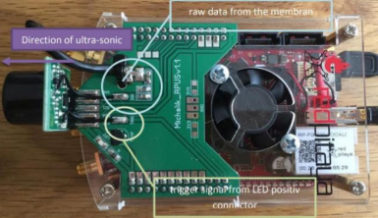
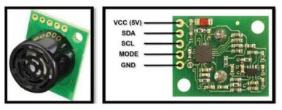
Overview of Sensor Used
Red Pitaya - Controller
SFR02 - Ultrasonic Sensor

Slide 7
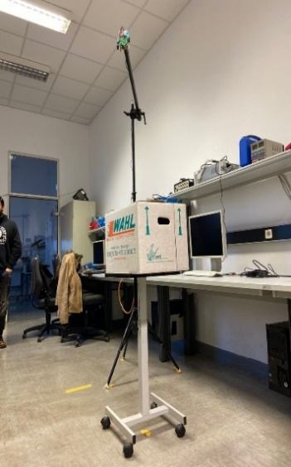

Overview of Setup
Static Object Setup
Dynamic Object Setup

Slide 8
Implementation

Slide 9
Flowchart
Load ADC data
Preprocess raw signal
Feature Extraction
Data Grouping & Labelling
MLP/Random Forest
Model validation
Model Testing
Predictions
Model Saving
Model Training

Slide 10
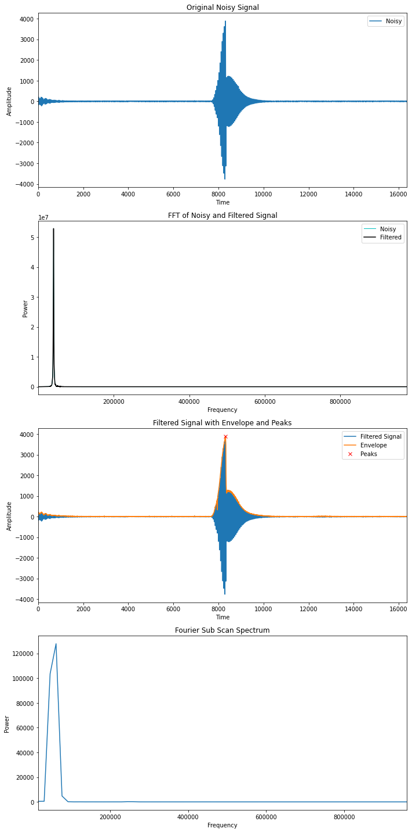
Pre-Processing of Signal
The signal was filtered by using the following :
Hilbert Transform
Fast Fourier Transform

Slide 11
Features Extraction
Time Based Features
Time of flight
First peak magnitude
Rate of change of distance
Frequency based features:
First peak frequency
RMS
Mean Frequency
Max frequency
Variance
Energy of the signal

Slide 12
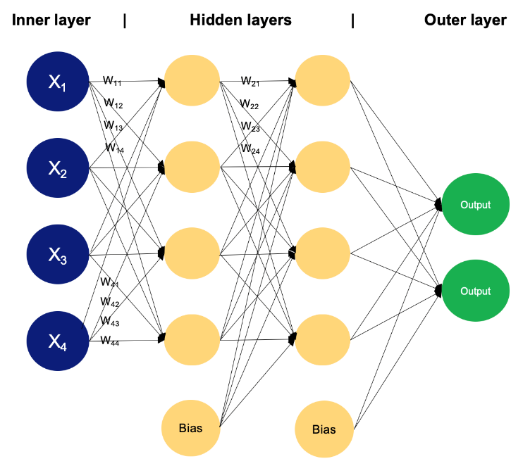
1. ML Model: Multilayers Perceptron(MLP)
MLP is a type of feedforward artificial neural network that consist of multiple layers of neurons( input, hidden, output)
Each neuron uses activation functions like ReLU to capture non-linear relationships in data. (relationships between features derived from sensor data, such as motion and environmental variables)
Features extracted are given as input and model is trained on labels(human / non human) and used back propagation and gradient descent to minimize loss.
To optimize for better performance tuning of hyperparameters are done.

Slide 13

2. ML Model: Random Forest
Random Forest is an ensemble learning method used for classification and regression. It builds multiple decision trees during training and combines their outputs for more accurate predictions.
For classification tasks, each tree votes, and the most common class is selected as the final prediction. This robust combination of outputs results in improved performance.
Random Forest excels in classifying complex datasets, making it ideal for distinguishing between subtle human movements and static objects.

Slide 14
Results

Slide 15
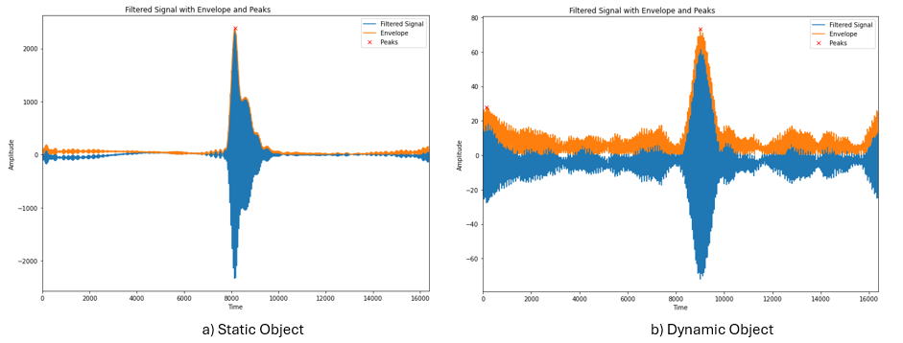
Pre-processing Signal

Slide 16
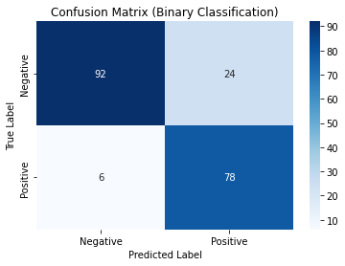
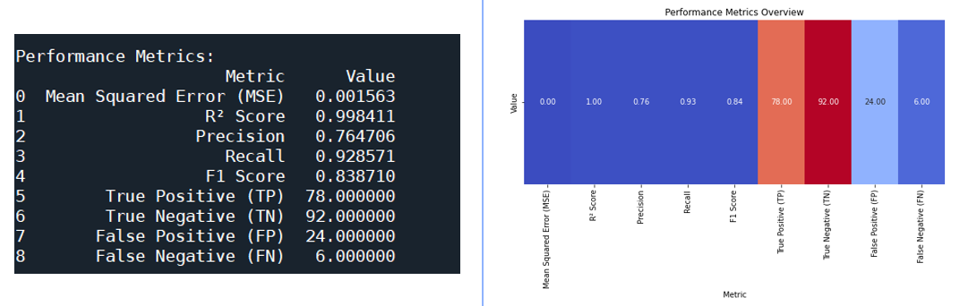
1. MLP: Results for Static Object

Slide 17
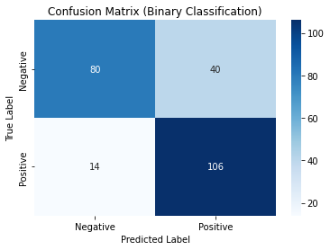
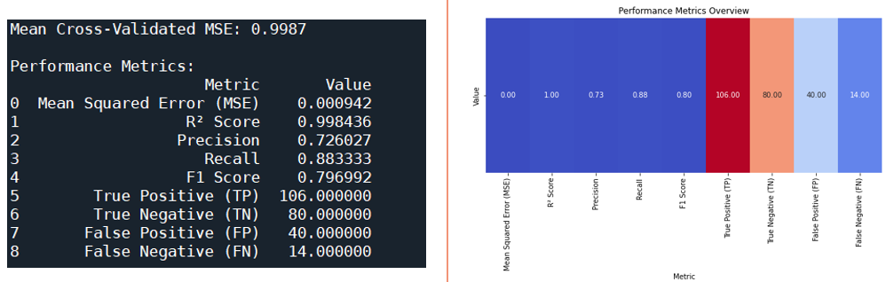
1. MLP: Results for Dynamic Object (Person Walking)

Slide 18
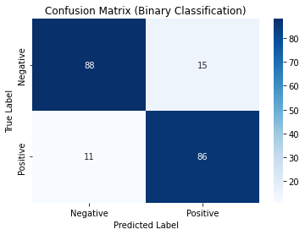
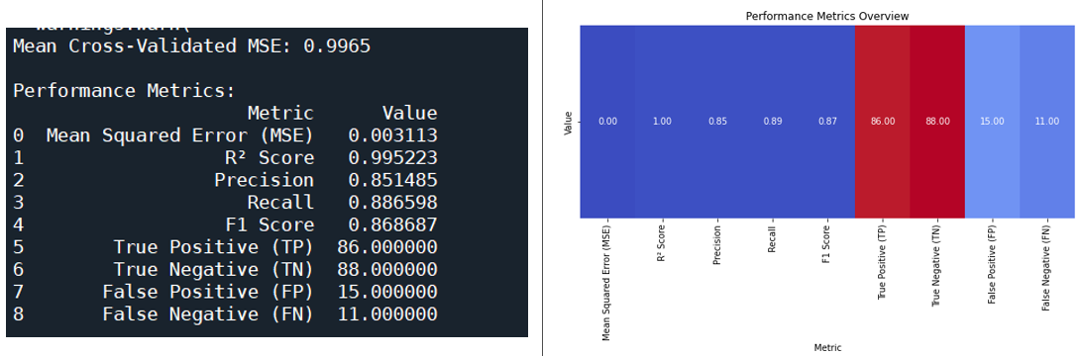
1. MLP: Results for Dynamic Object (Person Sitting)

Slide 19
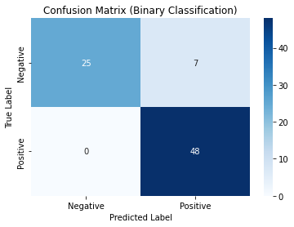
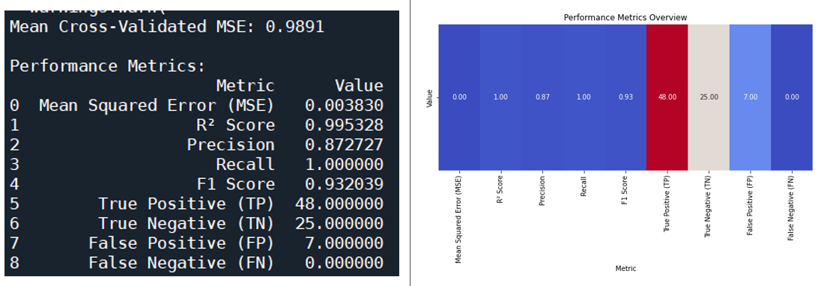
1. MLP: Results for Dynamic Object (Person Steady)

Slide 20
Analysis of MLP Results
High Performance for Static Detection: Excels at detecting motionless humans, achieving perfect recall and a high F1 score.
Challenges in Detecting Dynamic Movement: Faces limitations in precision when detecting activities like walking, resulting in more false positives.
Good Balance Between Precision and Recall: Maintains a solid trade-off between precision and recall, ensuring effective detection in varied scenarios.
Effective in Multiple Scenarios: Works well for detecting human presence in both static and dynamic environments, making it versatile.
Potential for Reducing False Alarms: Needs improvement in minimizing false positives, especially during dynamic movements.
Reliable for Smart Lighting Applications: Overall, the model is reliable but would benefit from further tuning to optimize performance in dynamic settings.

Slide 21
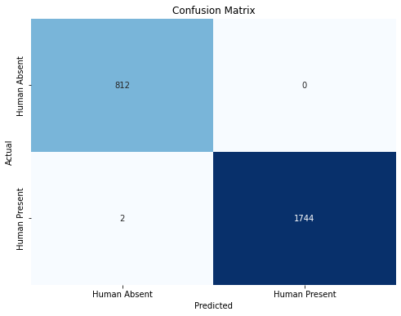
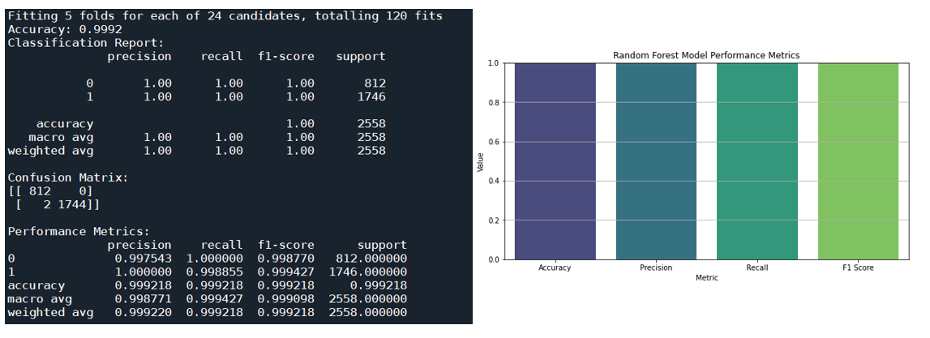
Random Forest : Results for Classification between Static and Dynamic Object.

Slide 22
Analysis of Random Forest Results
Flawless Performance Across Scenarios: Achieves near-perfect precision, recall, and F1 scores in both static and dynamic environments.
Highly Robust and Reliable: Demonstrates excellent performance in various conditions, ensuring accurate human presence detection.
Superior Accuracy: Maintains near-perfect accuracy, making it highly reliable for real-time applications in smart lighting systems.
Strong Generalization: Effectively handles diverse environmental setups, enhancing its ability to adapt to real-world scenarios.
Ideal for Energy Efficiency: Accurate detection of human presence ensures optimal energy usage, reducing unnecessary lighting.
Better candidate for Smart Lighting: Outperforms other models, proving to be the best choice for improving energy-efficient lighting control.

Slide 23
Conclusion

Slide 24
Conclusion
The project successfully aimed to enhance smart lighting by detecting human presence using ultrasonic sensors and machine learning models (MLP and Random Forest).
Model Performance: While the MLP model is effective in detecting static human presence, it struggles with false positives in dynamic scenarios. Random Forest, however, achieves near-perfect accuracy across all environments.
Energy Efficiency: Random Forest is the superior model, providing reliable human detection, minimizing false positives, and optimizing energy usage in smart lighting systems.

Slide 25
Thank You

